Slide 1


에디로봇아카데미
임베디드 마스터 Lv1 과정
제 #5기
2023. 06. 03
Lee Sungkill

Slide 2
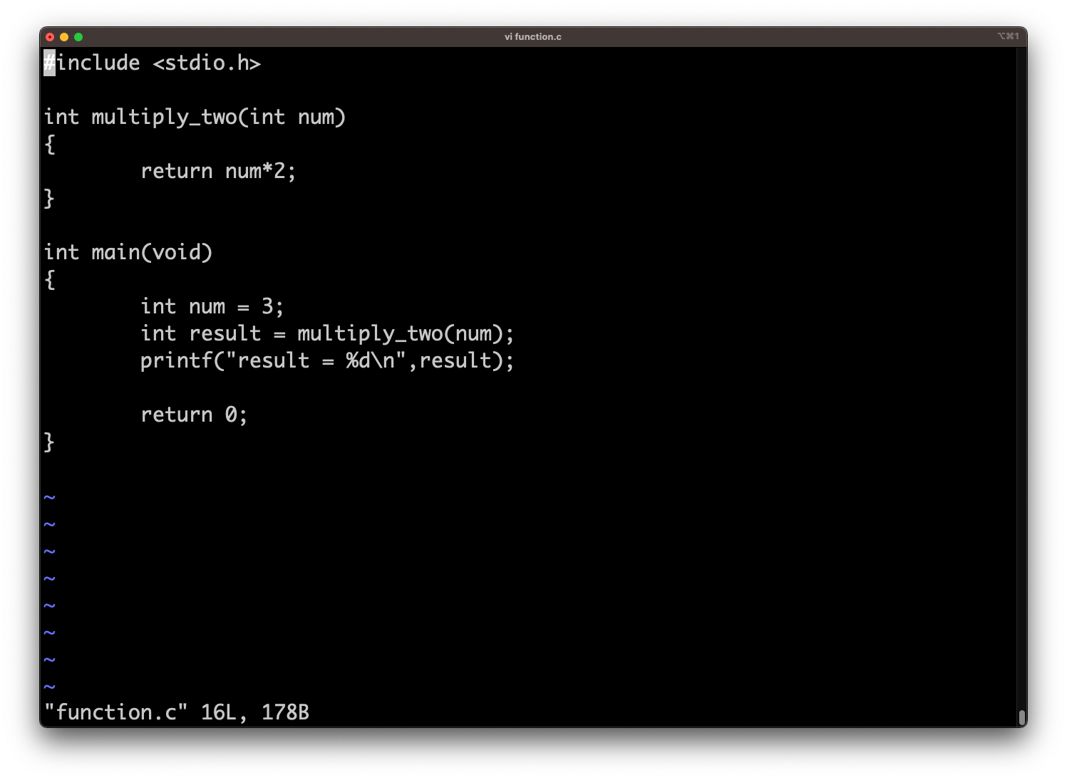
Function.c 파일 생성

Slide 3
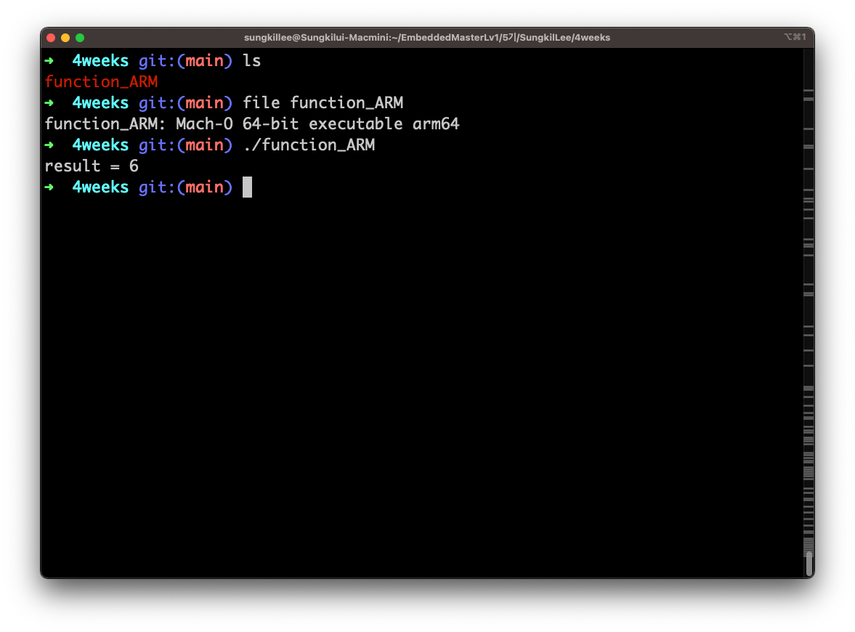
Function.c arm64 아키텍쳐 컴파일 실행 및 디버그 파일 생성

Slide 4
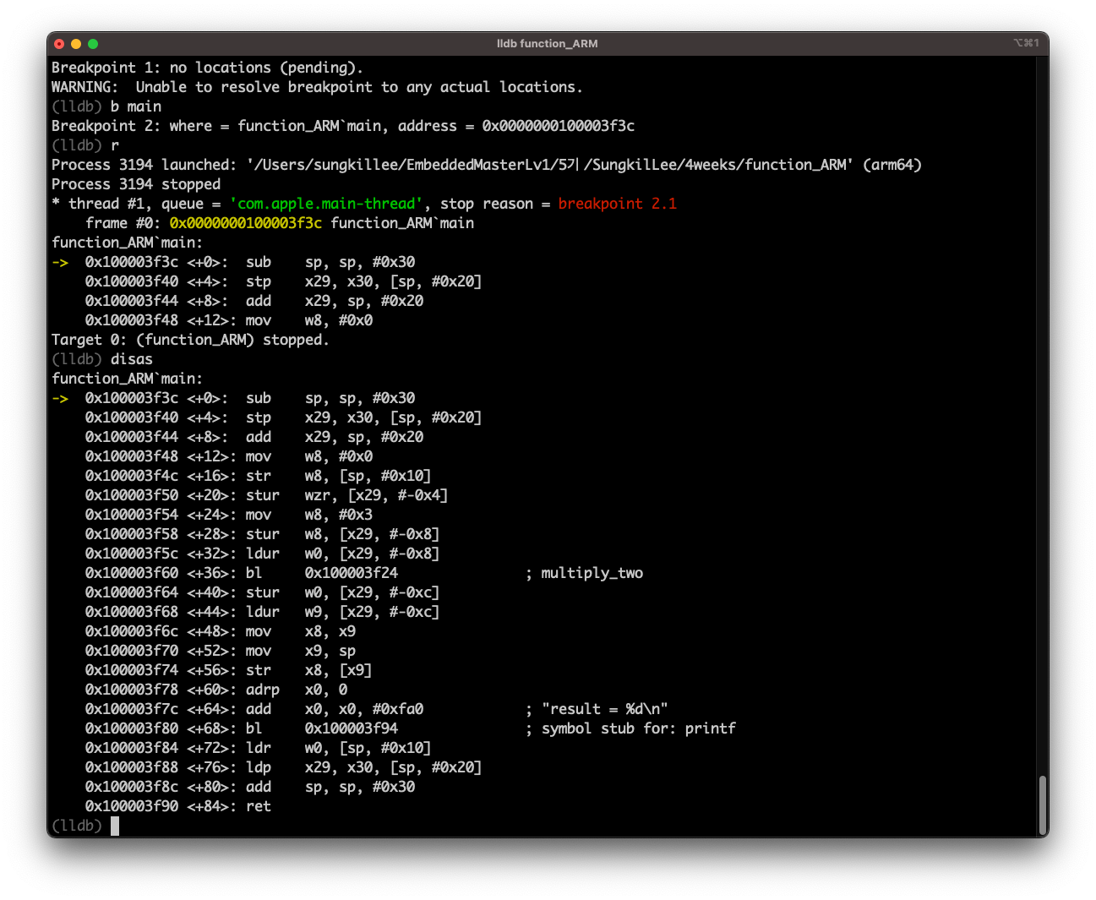
Function.c 디버깅

Slide 5
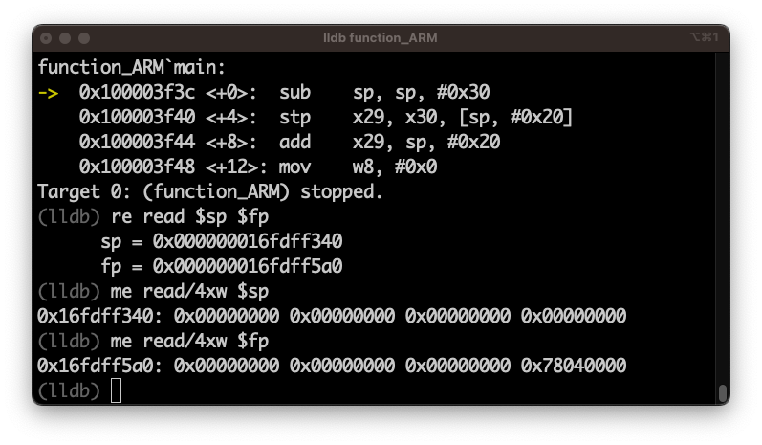
Function.c 디버깅
fp
0
0
0
78040000
16fdff5a0
sp
0
0
0
0
16fdff340

Slide 6
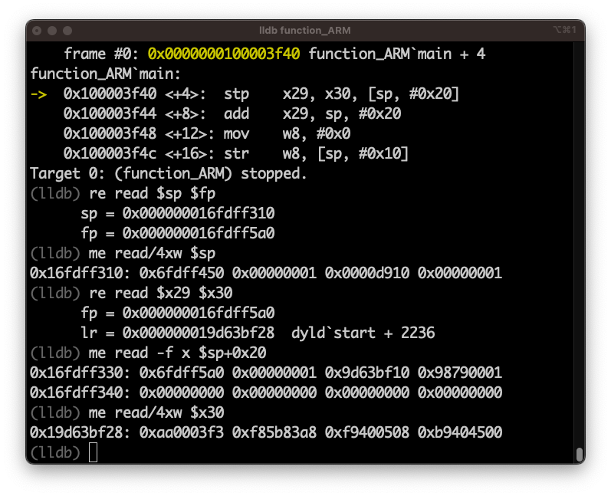
Function.c 디버깅
fp
0
0
0
78040000
x29
16fdff5a0
0
0
0
0
16fdff340
6fdff5a0
9d63bf10
98790001
16fdff330
1
16fdff320
sp
6fdff450
1
d910
1
16fdff310
lr
aa0003f3
x30
19d63bf28

Slide 7
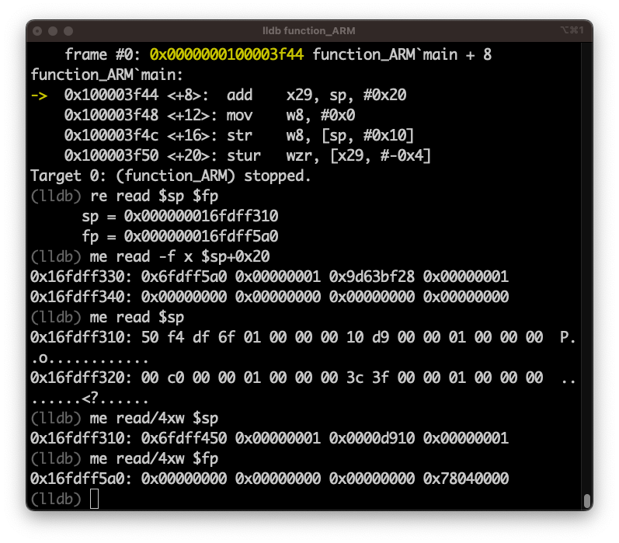
Function.c 디버깅
fp
0
0
0
78040000
x29
16fdff5a0
0
0
0
0
16fdff340
9d63bf28
16fdff330
6fdff5a0
1
1
16fdff320
sp
6fdff450
1
d910
1
16fdff310
lr
aa0003f3
x30
19d63bf28

Slide 8
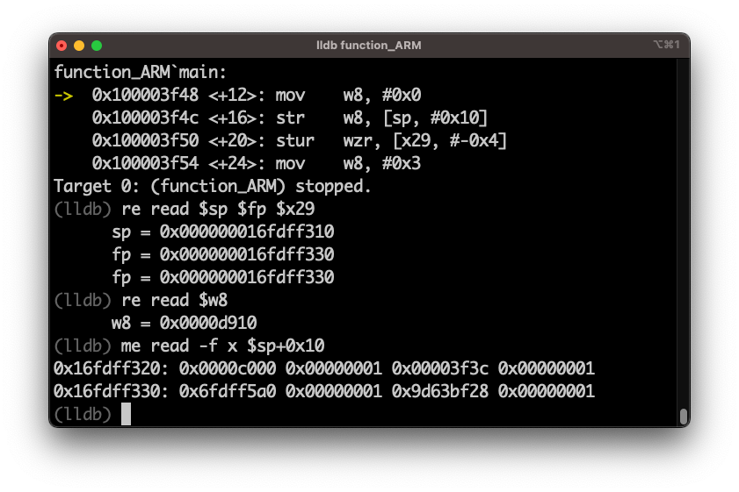
Function.c 디버깅
0
0
0
78040000
16fdff5a0
0
0
0
0
16fdff340
fp
9d63bf28
x29
16fdff330
6fdff5a0
1
1
c000
1
1
16fdff320
3f3c
sp
6fdff450
1
d910
1
16fdff310
w8
d910
lr
aa0003f3
x30
19d63bf28

Slide 9
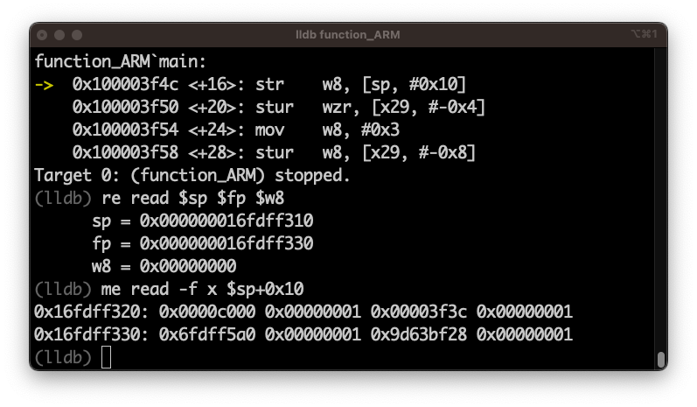
Function.c 디버깅
0
0
0
78040000
16fdff5a0
0
0
0
0
16fdff340
fp
9d63bf28
x29
16fdff330
6fdff5a0
1
1
c000
1
1
16fdff320
3f3c
sp
6fdff450
1
d910
1
16fdff310
w8
0
lr
aa0003f3
x30
19d63bf28

Slide 10
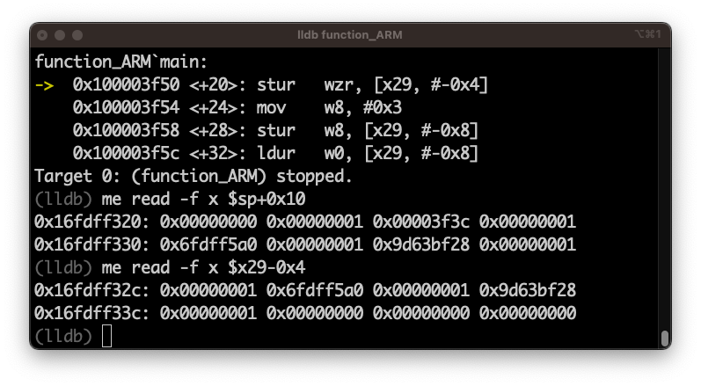
Function.c 디버깅
0
0
0
78040000
16fdff5a0
0
0
0
0
16fdff340
fp
9d63bf28
x29
16fdff330
6fdff5a0
1
1
0
1
1
16fdff320
3f3c
sp
6fdff450
1
d910
1
16fdff310
w8
0
lr
aa0003f3
x30
19d63bf28

Slide 11
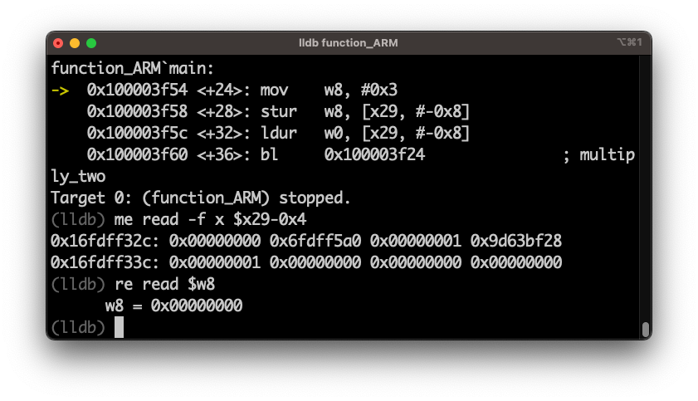
Function.c 디버깅
0
0
0
78040000
16fdff5a0
0
0
0
0
16fdff340
fp
9d63bf28
x29
16fdff330
6fdff5a0
1
1
0
1
0
16fdff320
3f3c
sp
6fdff450
1
d910
1
16fdff310
w8
0
lr
aa0003f3
x30
19d63bf28

Slide 12
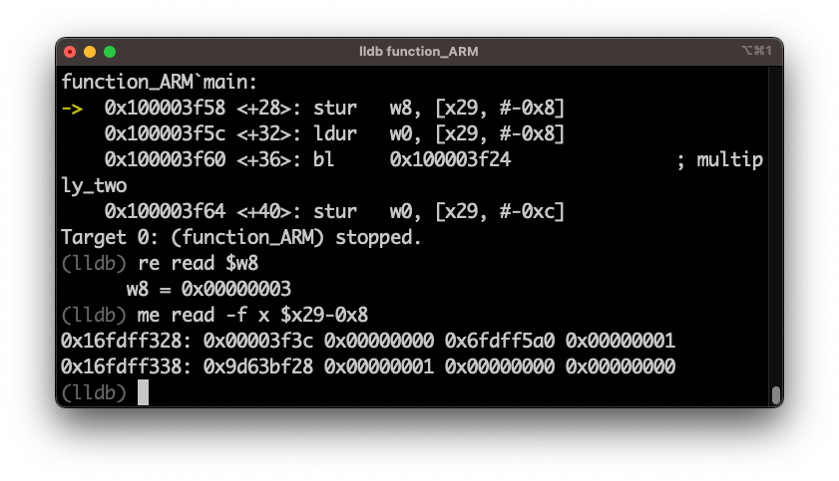
Function.c 디버깅
0
0
0
78040000
16fdff5a0
0
0
0
0
16fdff340
fp
9d63bf28
x29
16fdff330
6fdff5a0
1
1
0
1
0
16fdff320
3f3c
sp
6fdff450
1
d910
1
16fdff310
w8
3
lr
aa0003f3
x30
19d63bf28

Slide 13
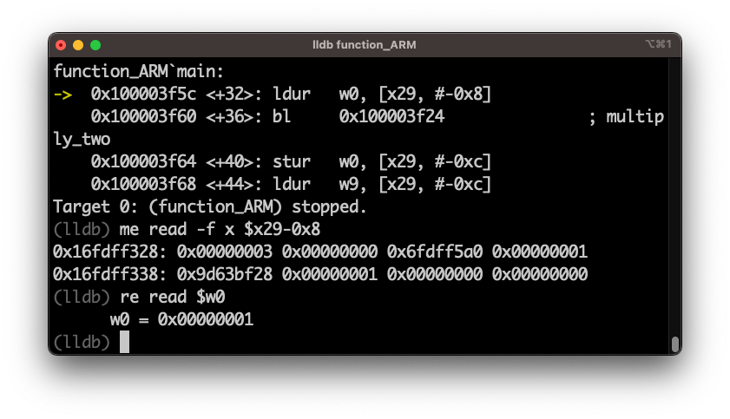
Function.c 디버깅
0
0
0
78040000
16fdff5a0
0
0
0
0
16fdff340
fp
9d63bf28
x29
16fdff330
6fdff5a0
1
1
3
0
16fdff320
0
1
sp
6fdff450
1
d910
1
16fdff310
w0
1
w8
3
lr
aa0003f3
x30
19d63bf28

Slide 14
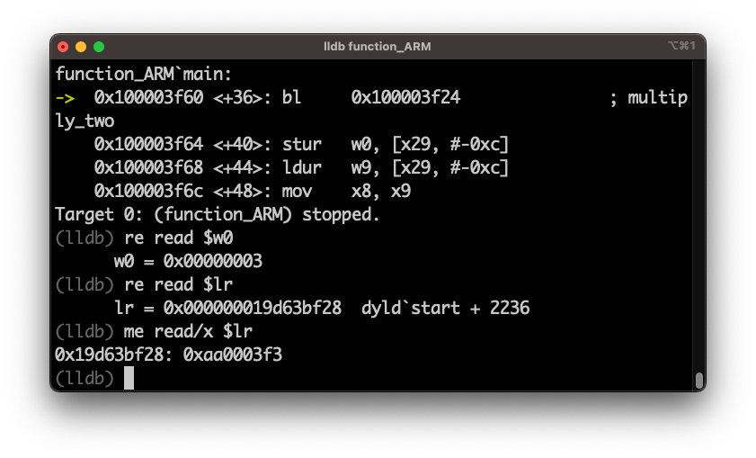
Function.c 디버깅
0
0
0
78040000
16fdff5a0
0
0
0
0
16fdff340
fp
9d63bf28
x29
16fdff330
6fdff5a0
1
1
3
0
16fdff320
0
1
sp
6fdff450
1
d910
1
16fdff310
w0
3
w8
3
lr
aa0003f3
x30
19d63bf28

Slide 15
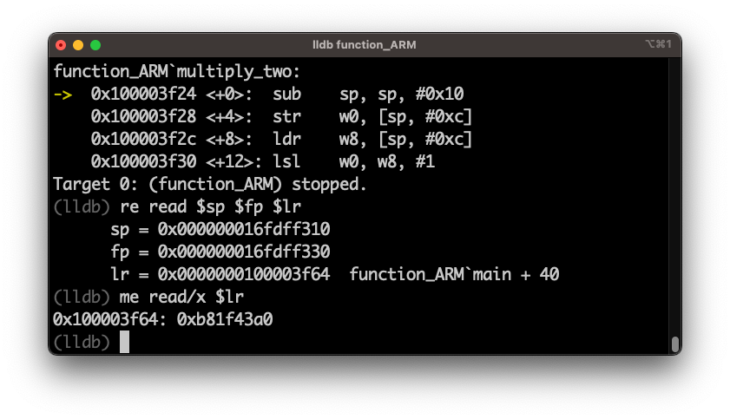
Function.c 디버깅
0
0
0
78040000
16fdff5a0
0
0
0
0
16fdff340
fp
9d63bf28
x29
16fdff330
6fdff5a0
1
1
3
0
16fdff320
0
1
sp
6fdff450
1
d910
1
16fdff310
w0
3
w8
3
lr
b81f43a0
x30
100003f64

Slide 16
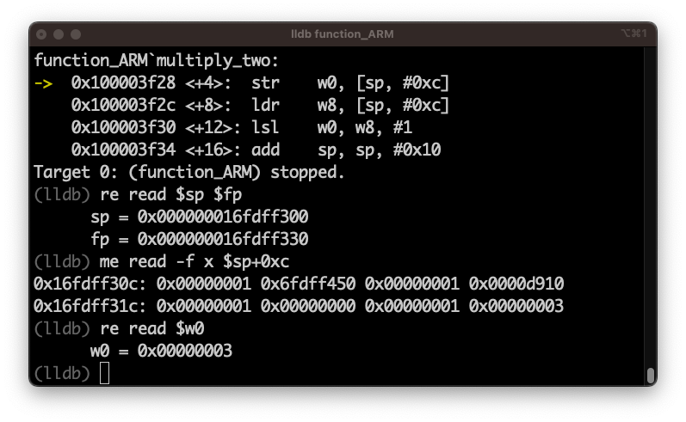
Function.c 디버깅
0
0
0
78040000
16fdff5a0
0
0
0
0
16fdff340
fp
9d63bf28
x29
16fdff330
6fdff5a0
1
1
3
0
16fdff320
0
1
6fdff450
1
d910
1
16fdff310
sp
6fdff3d0
1
9d6b6396
1
16fdff300
w0
3
w8
3
lr
b81f43a0
x30
100003f64

Slide 17
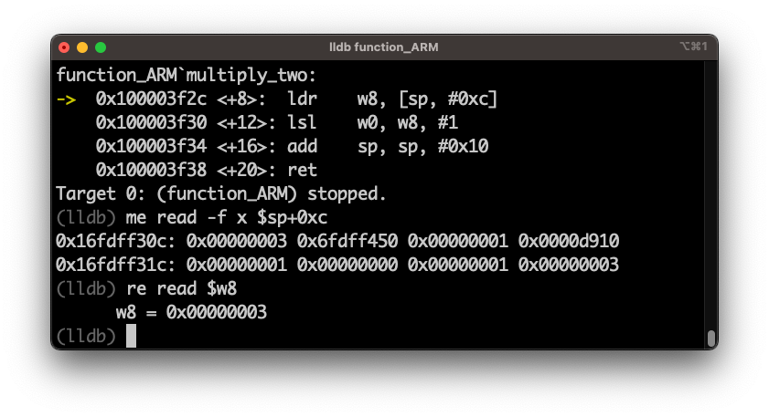
Function.c 디버깅
0
0
0
78040000
16fdff5a0
0
0
0
0
16fdff340
fp
9d63bf28
x29
16fdff330
6fdff5a0
1
1
3
0
16fdff320
0
1
6fdff450
1
d910
1
16fdff310
sp
6fdff3d0
1
9d6b6396
3
16fdff300
w0
3
w8
3
lr
b81f43a0
x30
100003f64

Slide 18
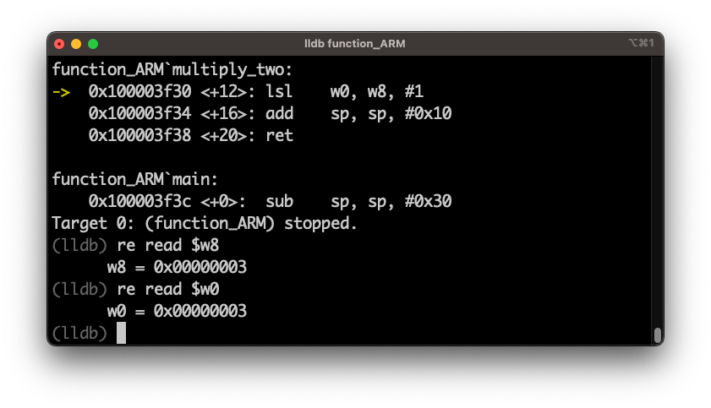
Function.c 디버깅
0
0
0
78040000
16fdff5a0
0
0
0
0
16fdff340
fp
9d63bf28
x29
16fdff330
6fdff5a0
1
1
3
0
16fdff320
0
1
6fdff450
1
d910
1
16fdff310
sp
6fdff3d0
1
9d6b6396
3
16fdff300
w0
3
w8
3
lr
b81f43a0
x30
100003f64

Slide 19
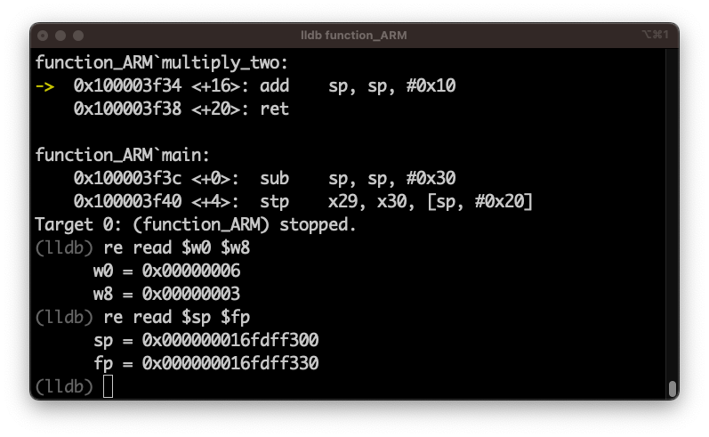
Function.c 디버깅
0
0
0
78040000
16fdff5a0
0
0
0
0
16fdff340
fp
9d63bf28
x29
16fdff330
6fdff5a0
1
1
3
0
16fdff320
0
1
6fdff450
1
d910
1
16fdff310
sp
6fdff3d0
1
9d6b6396
3
16fdff300
w0
6
w8
3
lr
b81f43a0
x30
100003f64

Slide 20
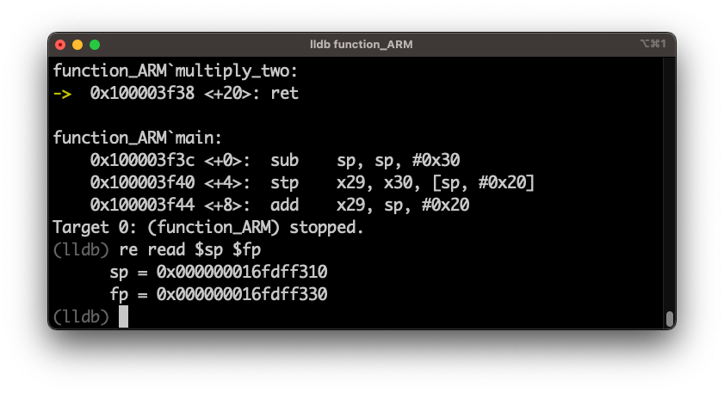
Function.c 디버깅
0
0
0
78040000
16fdff5a0
0
0
0
0
16fdff340
fp
9d63bf28
x29
16fdff330
6fdff5a0
1
1
3
0
16fdff320
0
1
sp
6fdff450
1
d910
1
16fdff310
6fdff3d0
1
9d6b6396
3
16fdff300
w0
6
w8
3
lr
b81f43a0
x30
100003f64

Slide 21
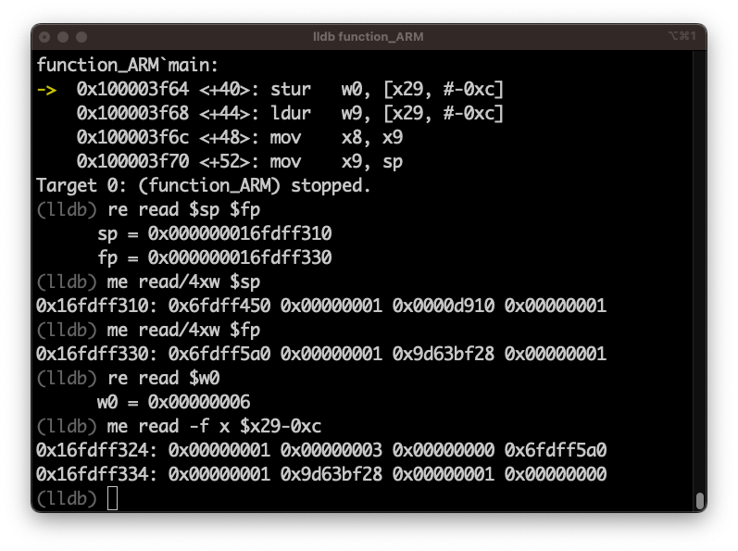
Function.c 디버깅
0
0
0
78040000
16fdff5a0
0
0
0
0
16fdff340
fp
9d63bf28
x29
16fdff330
6fdff5a0
1
1
3
0
16fdff320
0
1
sp
6fdff450
1
d910
1
16fdff310
6fdff3d0
1
9d6b6396
3
16fdff300
w0
6
w8
3
lr
b81f43a0
x30
100003f64

Slide 22
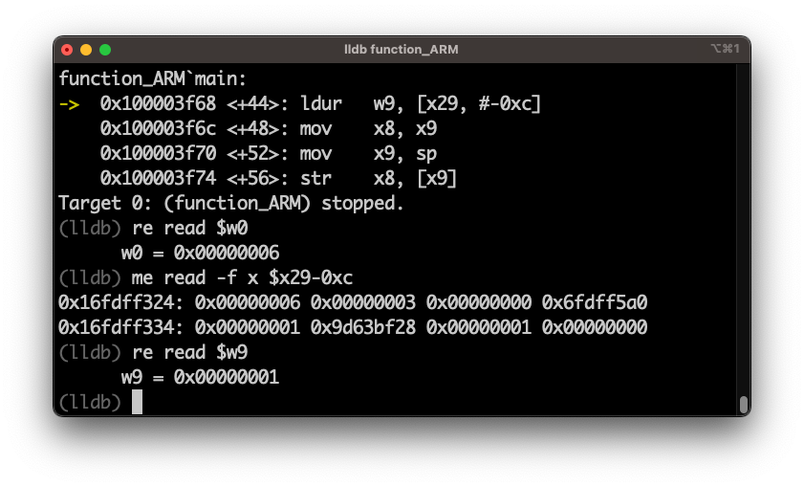
Function.c 디버깅
0
0
0
78040000
16fdff5a0
0
0
0
0
16fdff340
fp
9d63bf28
x29
16fdff330
6fdff5a0
1
1
3
0
16fdff320
0
6
sp
6fdff450
1
d910
1
16fdff310
6fdff3d0
1
9d6b6396
3
16fdff300
w0
6
w9
1
w8
3
lr
b81f43a0
x30
100003f64

Slide 23
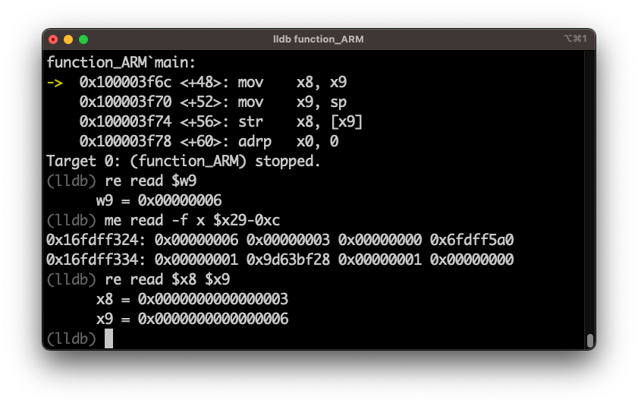
Function.c 디버깅
0
0
0
78040000
16fdff5a0
0
0
0
0
16fdff340
fp
9d63bf28
x29
16fdff330
6fdff5a0
1
1
3
0
16fdff320
0
6
sp
6fdff450
1
d910
1
16fdff310
6fdff3d0
1
9d6b6396
3
16fdff300
w0
6
x9
w9
6
x8
w8
3
lr
b81f43a0
x30
100003f64

Slide 24
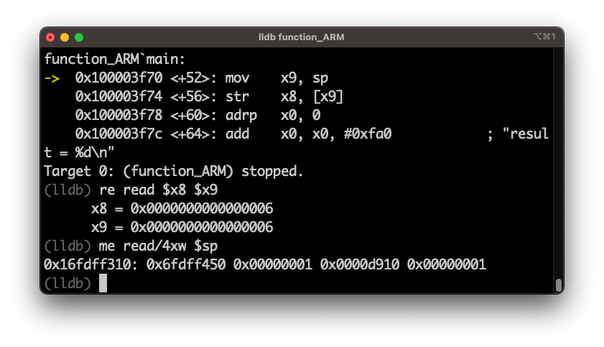
Function.c 디버깅
0
0
0
78040000
16fdff5a0
0
0
0
0
16fdff340
fp
9d63bf28
x29
16fdff330
6fdff5a0
1
1
3
0
16fdff320
0
6
sp
6fdff450
1
d910
1
16fdff310
6fdff3d0
1
9d6b6396
3
16fdff300
w0
6
x9
w9
6
x8
w8
6
lr
b81f43a0
x30
100003f64

Slide 25
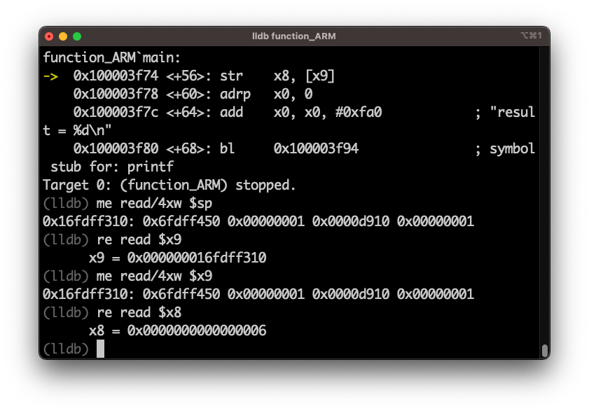
Function.c 디버깅
0
0
0
78040000
16fdff5a0
0
0
0
0
16fdff340
fp
9d63bf28
x29
16fdff330
6fdff5a0
1
1
3
0
16fdff320
0
6
sp
6fdff450
1
d910
1
x9
16fdff310
6fdff3d0
1
9d6b6396
3
16fdff300
w0
6
6fdff450
d910
w9
16fdff310
x9
1
1
x8
w8
6
lr
b81f43a0
x30
100003f64

Slide 26
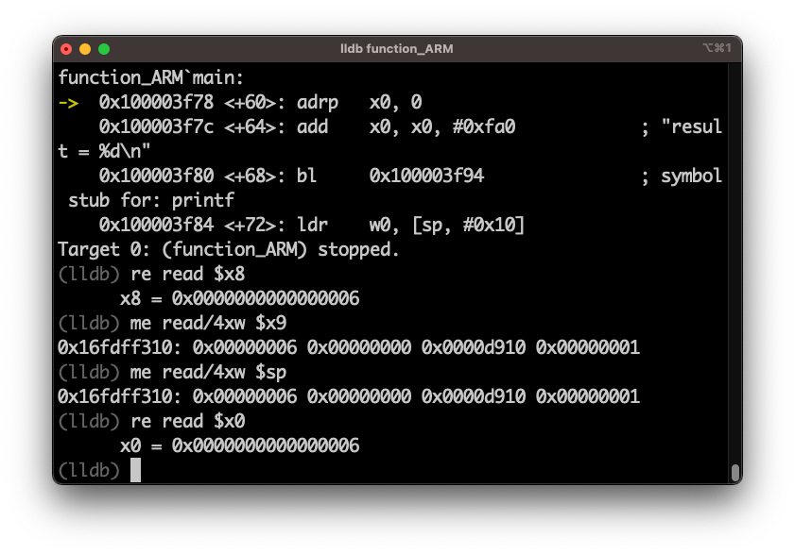
Function.c 디버깅
0
0
0
78040000
16fdff5a0
0
0
0
0
16fdff340
fp
9d63bf28
x29
16fdff330
6fdff5a0
1
1
3
0
16fdff320
0
6
sp
6
0
d910
1
x9
16fdff310
6fdff3d0
1
9d6b6396
3
16fdff300
x0
w0
6
6
d910
w9
16fdff310
x9
0
1
x8
w8
6
lr
b81f43a0
x30
100003f64

